Slide 1
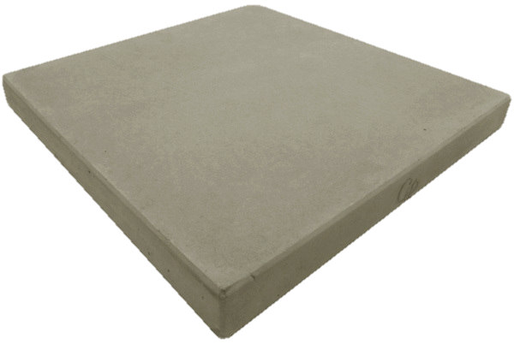
Leaching of heavy metals from concrete pavers containing waste-to-energy bottom ash as an aggregate
Sb(OH)₆⁻
Zn²⁺
Prof Jo Van Caneghem, KU Leuven – Faculty of Engineering Technology
Joost de Wijs, AEB Amsterdam, 1045 BA Amsterdam, The Netherlands
Jeroen Sala, Bontrup, 1045 AC Amsterdam, The Netherlands
Cu²⁺
CrO₄²⁻
AsO₄³⁻
Cd²⁺
Pb²⁺

Slide 2
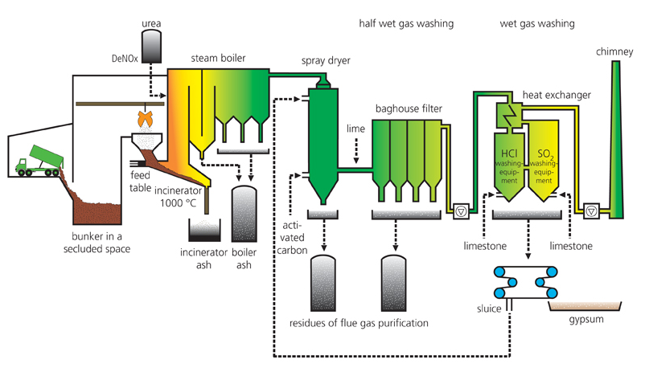
Waste-to-energy bottom ash
1 000 kg
220 kg

Slide 3
Waste-to-energy bottom ash treatment
18 kg
220 kg
22 kg
50 kg
11 kg
30 kg
Filter cake < 0.67 mm
Sand 0.67- 2 mm
20 kg
70 kg

Slide 4

Waste-to-energy bottom ash as building material
To be used as building material, bottom ash has to comply with legal leaching limit values
  Limit values typically apply for heavy metals, sulfates and halides
Natural carbonation of bottom ash can however enhance heavy metal leaching
Research question: if bottom ash is used as an aggregate in shaped concrete materials that are exposed to ambient air for many decades, will this increase leaching of heavy metals from the BA in these materials?

Slide 5
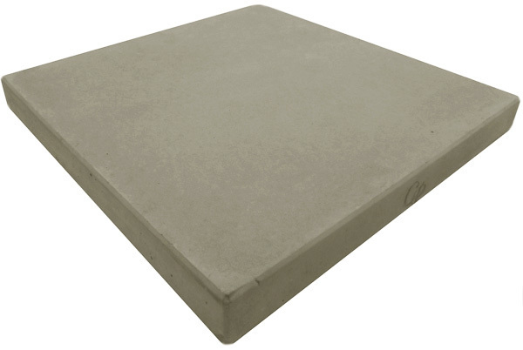
Materials and methods
Concrete pavers (0,3mx0,3mx0,045m)
  Top layer (6 mm), base layer (39 mm)
  CEM III/A
  Limestone
  Aggregates
    Fine and coarse sand
    Gravel
    Granite stone
    IBC compliant waste-to-energy bottom ash (< 17%) – only in base layer

Slide 6
Materials and methods
Enhanced carbonation of pavers
  Incubator at 20vol% CO₂, 30°C and 70% humidity
  14 days
→ diffusion test (CMA/2/II/A.9.2), in parallel with non-carbonated paver
CO₂
CO₂
CO₂
CO₂
CO₂
CO₂
Diffusion test
Crushing
Diffusion test
Crushing

Slide 7
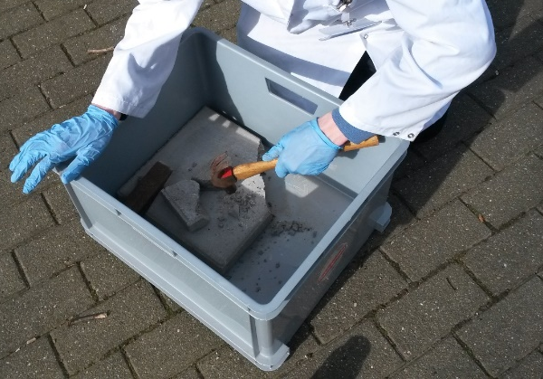
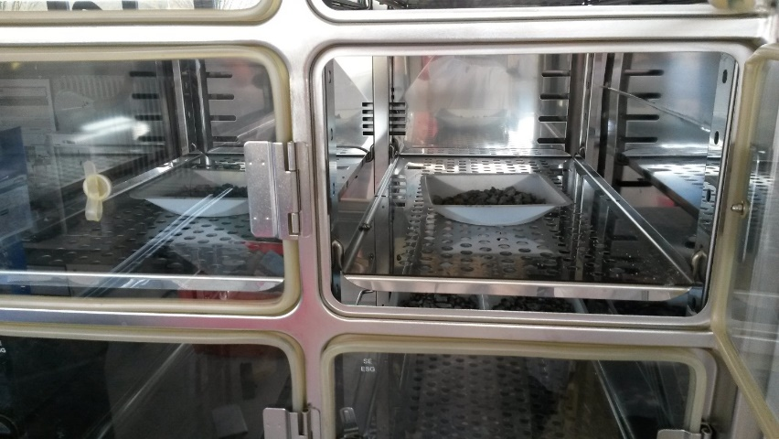
Materials and methods
Crushing of carbonated paver → “0 – 31.5 mm” granulates → CO₂ incubator
CO₂
Simulate second life as recycled granulate
CO₂
CO₂
Sampled after 3, 7, 10, 14 and 17 days → a shaking test
17 days sample → column test (NEN 7383 AP04)
Shaking test
Column test

Slide 8
Materials and methods
Eluate analysis (diffusion and shaking test)
  Regulated heavy metals and sulfur
    ICP-OES (Varian 720-ES)
  Chlorides
    IC (Dionex type ICS2000)
Column test
  Accredited lab

Slide 9
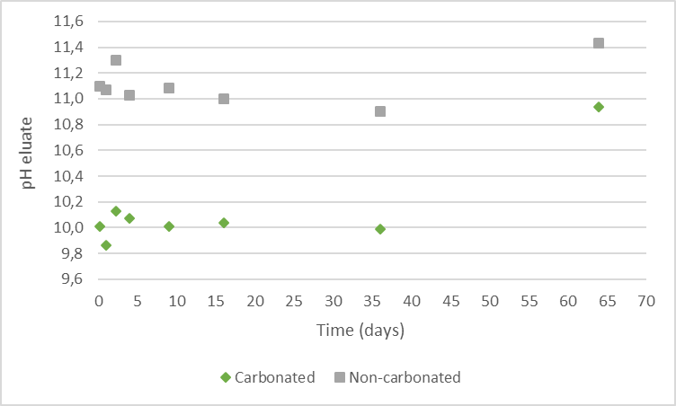
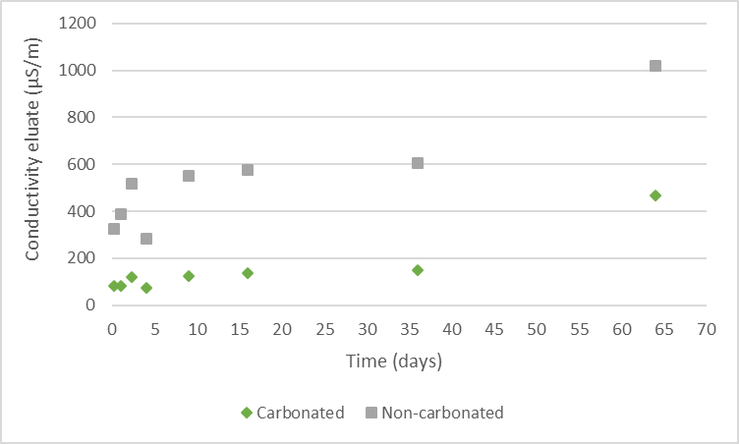
Results diffusion tests
pH and conductivity
Notes:
Same trend, but lower for the carbonated paver, clear effect of carbonation

Slide 10
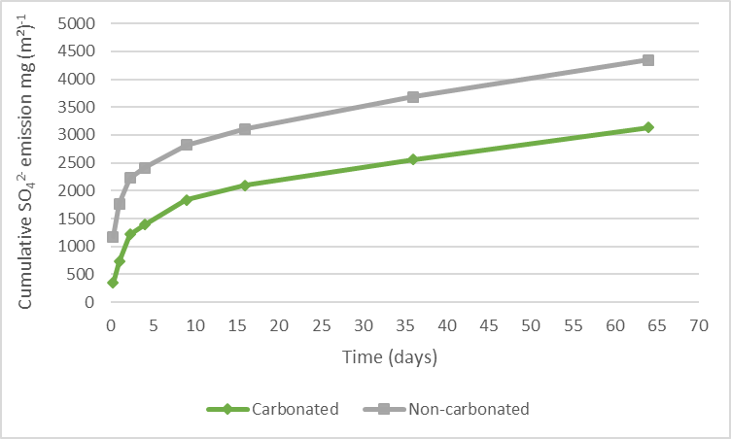
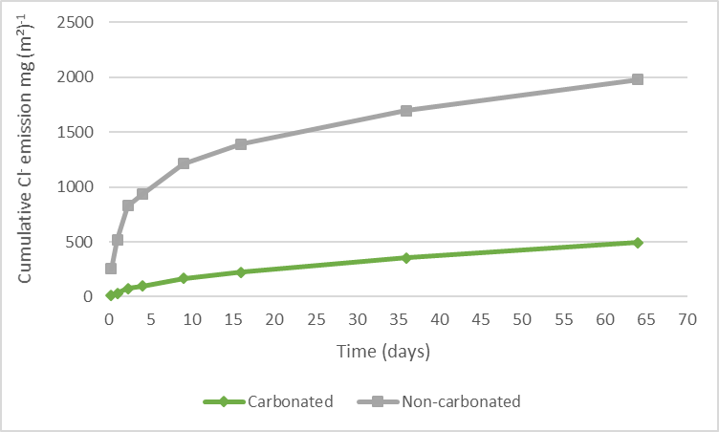
Results diffusion tests
Sulfate and chloride emission
Notes:
Same trend, but lower for the carbonated paver, clear effect of carbonation

Slide 11
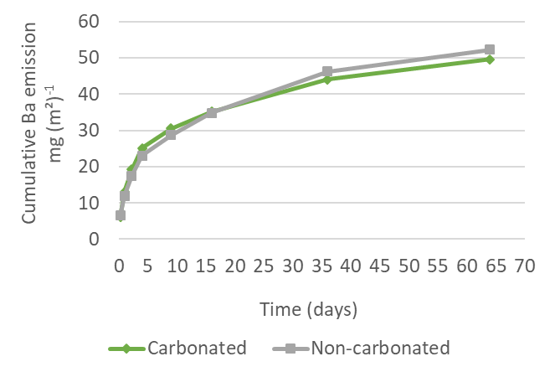
Results diffusion tests
Heavy metal emissions
  Below detection limit for most heavy metals
    Except Barium
  Cumulative emission after 64 days below the Dutch limit value for all regulated heavy metals
    Even with emission = detection limit
Notes:
Emission rates decrease quadratically over time. No noticable difference between carbonated and non-carbonated paver

Slide 12
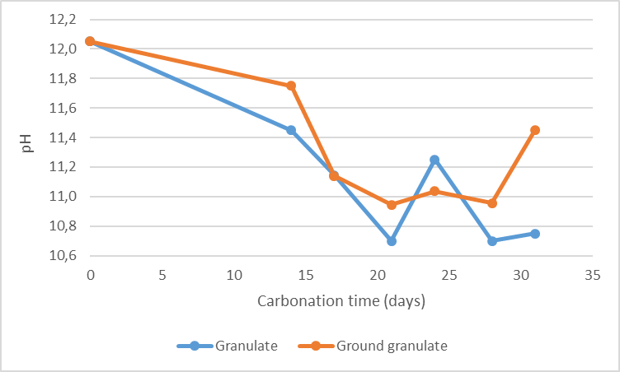
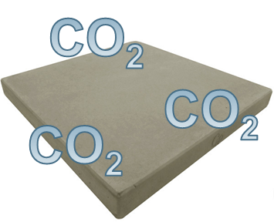
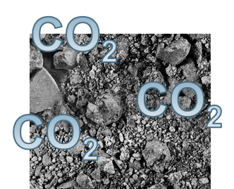
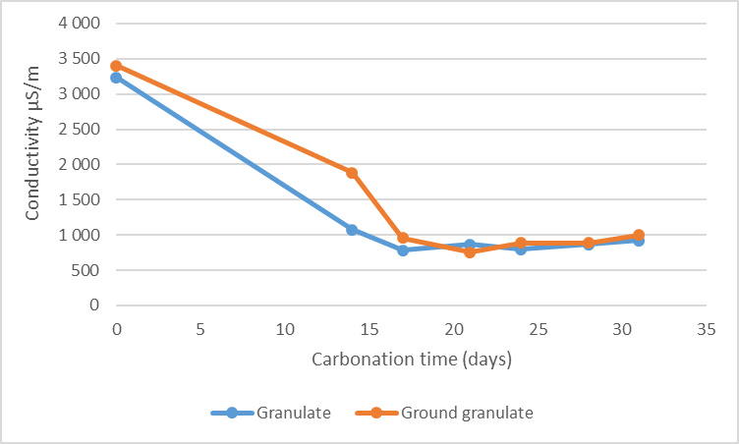
Results shaking tests (granulates crushed pavers)
pH and conductivity
Crushed carbonated paver
Carbonation as paver
Carbonation as granulate
Non-carbonated crushed paver
Notes:
Clear effect of carbonation, seems to stabilise after 7 days in incubator as a granulate

Slide 13
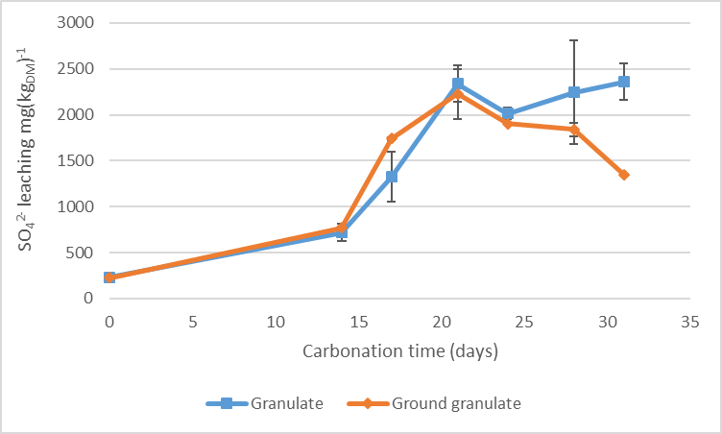
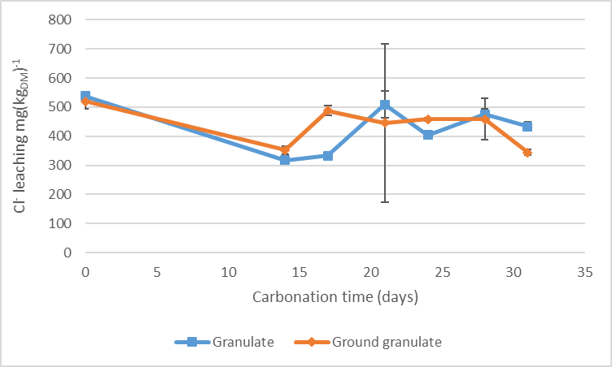
Results shaking tests (granulates crushed pavers)
Sulfate and chloride leaching
Notes:
Remarkable increase insulphate leaching, linked to break down of ettringite minerals as function of pH; chlorides no further effect of carbonation

Slide 14
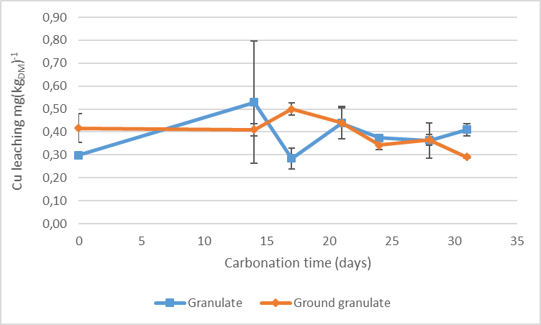
Results shaking tests (granulates crushed pavers)
Heavy metal leaching
  As, Cd, Co, Pb, Se and Sn: concentration in eluates mostly below detection limit
  Ba, Cr, Cu, Mo and V: concentration in eluates mostly above detection limit, but no obvious trend

Slide 15
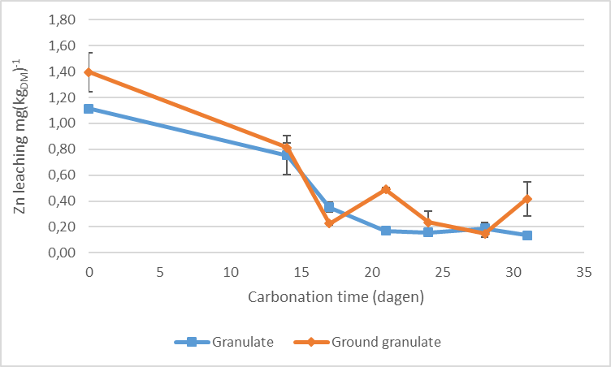
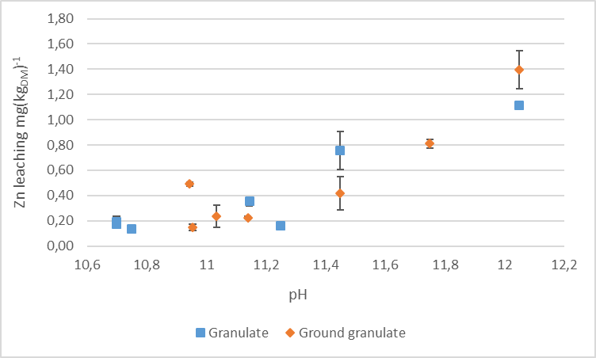
Results shaking tests (granulates crushed pavers)
Leaching of Zn
  Decrease with carbonation time
  Equilibrium after 14 + 7 days
  Decrease function of pH

Slide 16
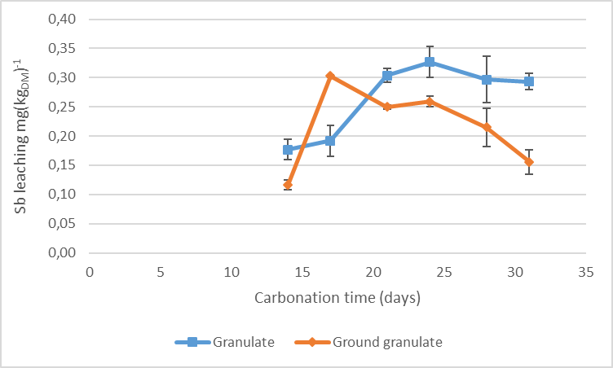
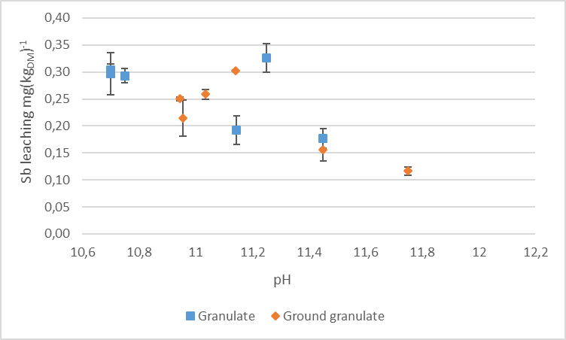
Results shaking tests (granulates crushed pavers)
Leaching of Sb
  Significant difference between trend granulate and ground granulate
  Follows earlier established leaching trend as function of pH
  Similar trend sulfate emission
    Breakdown of ettringite minerals
    Possibly Sb(OH)₆⁻ incorporation in or adsorbtion to ettringite minerals

Slide 17
Results shaking tests (granulates crushed pavers)
Leaching of Sb
  Significant difference between trend granulate and ground granulate
  Follows earlier established leaching trend as function of pH
  Similar trend sulfate emission
    Breakdown of ettringite minerals
    Possibly Sb(OH)₆⁻ incorporation in or adsorbtion to ettringite minerals

Slide 18
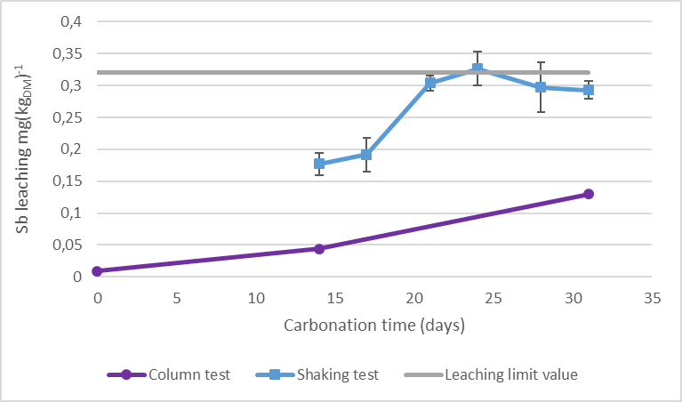
Results column tests
Trend pH, conductivity and leaching of heavy metals comparable to trend shaking test
Exception: leaching of Sb
All values below the legal limit values

Slide 19
Conclusions
Paver containing waste-to-energy bottom ash complied with Dutch legal limit values for shaped building materials
  Also after 14 days @ 20vol% CO₂, 30°C and 70% humidity
Granulates from carbonated pavers:
  Carbonation: chemical equilibrium reached after 7 days
  Comply with Dutch legal limit values for uncontained building materials after 17 days of carbonation
Leaching of Sb from carbonated granulates
  Linked to destruction of ettringite minerals
  Effect of physical aspects interaction water/solid phase: particle size, porosity

